Slide 1

Department of FOT
01CE0101 - Computer Programming
Unit – 8
File Management

Slide 2
File Management
A File can be used to store a large volume of persistent data. Like many other languages 'C' provides following file management functions,
Creation of a file
Opening a file
Reading a file
Writing to a file
Closing a file

Slide 3
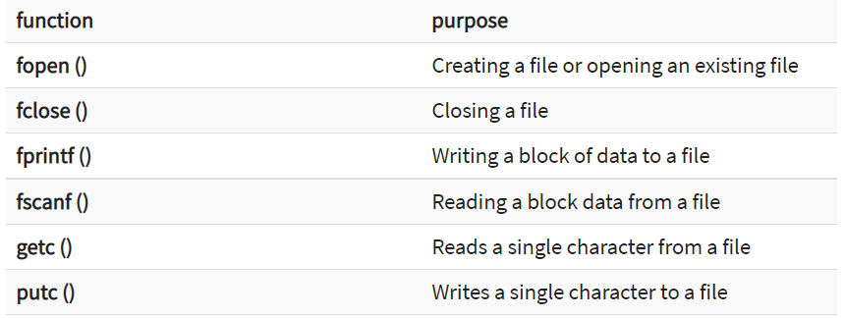
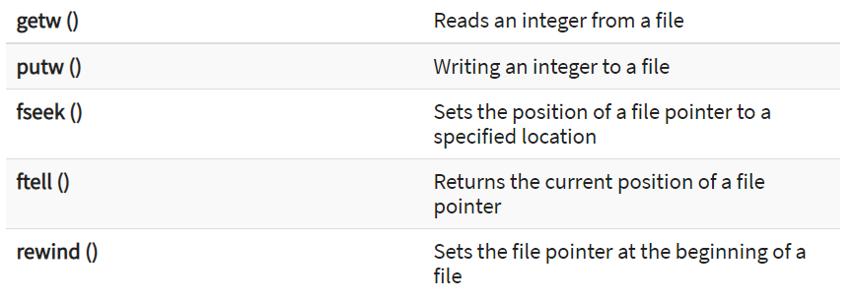
Important file management functions

Slide 4
Create a File
Whenever we want to work with a file, the first step is to create a file. A file is nothing but space in a memory where data is stored.
To create a file in a ‘C’ program following syntax is used,
FILE *fp;
fp = fopen ("file_name", "mode");
In the above syntax, the file is a data structure which is defined in the standard library.
fopen is a standard function which is used to open a file.
If the file is not present on the system, then it is created and then opened.
If a file is already present on the system, then it is directly opened using this function.
fp is a file pointer which points to the type file.

Slide 5
File modes
Whenever you open or create a file, you have to specify what you are going to do with the file.
A file in ‘C’ programming can be created or opened for reading/writing purposes.
A mode is used to specify whether you want to open a file for any of the below-given purposes.
Following are the different types of modes in ‘C’ programming which can be used while working with a file.

Slide 6
File modes
File Mode | Description
r | Open a file for reading. If a file is in reading mode, then no data is deleted if a file is already present on a system.
w | Open a file for writing. If a file is in writing mode, then a new file is created if a file doesn’t exist at all. If a file is already present on a system, then all the data inside the file is truncated, and it is opened for writing purposes.
a | Open a file in append mode. If a file is in append mode, then the file is opened. The content within the file doesn’t change.
r+ | open for reading and writing from beginning
w+ | open for reading and writing, overwriting a file
a+ | open for reading and writing, appending to file

Slide 7
File modes
Read (r)
The pointer starts at the beginning of the file.
You cannot modify or add data to the file.
It only allows reading the file’s data.
Write (w)
The pointer starts at the beginning of the file.
If there’s existing data, it is replaced with the new data you write.
Append (a)
The pointer moves to the end of the file before writing, so data is appended rather than overwriting.

Slide 8
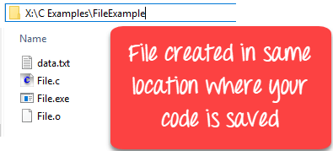
Example
#include <stdio.h>
int main()
{
FILE *fp;
fp = fopen ("data.txt", "w");
}

Slide 9
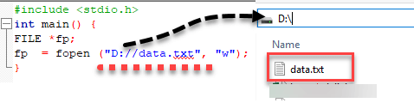
Example
You can specify the path where you want to create your file.
#include <stdio.h>
int main()
{
FILE *fp;
fp = fopen ("D://data.txt", "w");
}

Slide 10
Close a file
One should always close a file whenever the operations on file are over.
It means the contents and links to the file are terminated. This prevents accidental damage to the file.
‘C’ provides the fclose function to perform file closing operation.
The syntax of fclose is as follows,
fclose (file_pointer);

Slide 11
Example
FILE *fp;
fp = fopen ("data.txt", "r");
fclose (fp);
The fclose function takes a file pointer as an argument. The is then closed with the help of fclose function file associated with the file pointer
It returns 0 if close was successful and EOF (end of file) if there is an error has occurred while file closing.
After closing the file, the same file pointer can also be used with other files.
In ‘C’ programming, files are automatically close when the program is terminated. Closing a file manually by writing fclose function is a good programming practice.

Slide 12
Writing to a File
In C, when you write to a file, newline characters ‘\n’ must be explicitly added.
The stdio library offers the necessary functions to write to a file:
fputc(char, file_pointer): It writes a character to the file pointed to by file_pointer.
fputs(str, file_pointer): It writes a string to the file pointed to by file_pointer.
fprintf(file_pointer, str, variable_lists): It prints a string to the file pointed to by file_pointer. The string can optionally include format specifiers and a list of variables variable_lists.

Slide 13
Writing to a File
fputc: Use when you need to write one character at a time to a file.
fputs: Use when you need to write a whole string without any formatting or newline at the end. When you want to write a string of characters to a file, but without adding any formatting (e.g., no newlines).
fprintf: Use when you need to write formatted data (like integers, floats, or strings) to a file.

Slide 14
fputc() Function
#include <stdio.h>
int main()
{
FILE *fp;
int i;
char str[] = "File operations, writing the data here...\n";
fp = fopen ("data.txt", "w");
for (i = 0; str[i] != '\n'; i++)
{
fputc(str[i], fp);
}
fclose(fp);
return 0;
}
The above program writes a single character into the data.txt file until it reaches the next line symbol “\n” which indicates that the sentence was successfully written.
The process is to take each character of the array and write it into the file.

Slide 15


fputc() Function
In the above program, we have created and opened a file called fputc_test.txt in a write mode and declare our string which will be written into the file.
We do a character by character write operation using for loop and put each character in our file until the “\n” character is encountered then the file is closed using the fclose function.

Slide 16
fputs () Function
#include <stdio.h>
int main()
{
FILE * fp;
fp = fopen(“fputs.txt", "w+");
fputs(“1.This is fputs function,", fp);
fputs("We don't need to use for loop\n", fp);
fclose(fp);
return (0);
}
In the above program, we have created and opened a file called fputs.txt in a write mode.
After we do a write operation using fputs() function by writing two different strings
Then the file is closed using the fclose function.

Slide 17
fprintf() Function
#include <stdio.h>
int main()
{
FILE *fptr;
fptr = fopen("fprintf_test.txt", "w");
/* write to file */
fprintf(fptr, "Learning C Programming \n");
fclose(fptr);
return 0;
}
In the above program we have created and opened a file called fprintf_test.txt in a write mode.
After a write operation is performed using fprintf() function by writing a string, then the file is closed using the fclose function.

Slide 18
Question
Write C program to creates a new file named myfile.txt in writing mode, writes your name into this file, and then closes the file.

Slide 19
Reading data from a File
There are three different functions dedicated to reading data from a file
fgetc(file_pointer): It returns the next character from the file pointed to by the file pointer. When the end of the file has been reached, the EOF is sent back.
fgets(buffer, n, file_pointer): It reads n-1 characters from the file and stores the string in a buffer in which the NULL character ‘\0’ is appended as the last character.
fscanf(file_pointer, conversion_specifiers, variable_adresses): It is used to parse and analyze data. It reads characters from the file and assigns the input to a list of variable pointers variable_adresses using conversion specifiers. Keep in mind that as with scanf, fscanf stops reading a string when space or newline is encountered.

Slide 20
Reading data from a File using fgets
#include <stdio.h>
int main()
{
FILE * fp;
char b[30], c;
fp= fopen("fputs.txt", "r");
printf("----read a line----\n");
fgets(b, 50, fp); // Reading file upto 50 characters
printf("%s\n", b);
printf("----read and parse data----\n");
fp = fopen("fputs.txt", "r");
char str1[20], str2[20], str3[20], str4[20]; //declare 4 strings
// Using fscanf to read the first four words from the file
fscanf(fp, "%s %s %s %s", str1, str2, str3, str4);
//Printing the values of record
printf("Read String1 |%s|\n", str1);
printf("Read String2 |%s|\n", str2);
printf("Read String3 |%s|\n", str3);
printf("Read String4 |%s|\n", str4);
//Re opening the file again for reading
printf("----read the entire file----\n");
fp = fopen("fputs.txt", "r");
//read char from file until EOF
while ((c = getc(fp)) != EOF)
printf("%c", c);
fclose(fp);
return 0;
}

Slide 21
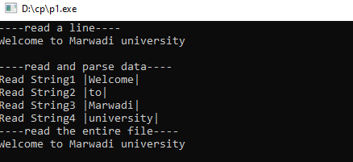
Reading data from a File using fgets

Slide 22
Reading data from a File using fgets
In the above program, we have opened the file called “fputs.txt” which was previously written using fprintf() function, and it contains “Welcome to Marwadi university” string. We read it using the fgets() function which reads line by line where the buffer size must be enough to handle the entire line.
We reopen the file to reset the pointer file to point at the beginning of the file. Create various strings variables to handle each word separately. Print the variables to see their contents. The fscanf() is mainly used to extract and parse data from a file.

Slide 23
Reading data from a File using fgets
3. Reopen the file to reset the pointer file to point at the beginning of the file. Read data and print it from the file character by character using getc() function until the EOF statement is encountered
4. After performing a reading operation file using different variants, we again closed the file using the fclose function.

Slide 24
Program to copy source file to destination file.
#include <stdio.h>
#include <stdlib.h>
int main()
{
char ch;// source_file[20], target_file[20];
FILE *source, *target;
char source_file[]="x1.txt";
char target_file[]="x2.txt";
source = fopen(source_file, "r");
if (source == NULL) {
printf("Press any key to exit...\n");
exit(EXIT_FAILURE);
}

Slide 25
Program to copy source file to destination file.
target = fopen(target_file, "w");
if (target == NULL) {
fclose(source);
printf("Press any key to exit...\n");
exit(EXIT_FAILURE);
}
while ((ch = fgetc(source)) != EOF)
fputc(ch, target);
printf("File copied successfully.\n");
fclose(source);
fclose(target);
return 0;
}
Output:
Before execution
X1.txt
Hi welcome to Marwadi
X2.txt
After execution
X1.txt
Hi welcome to Marwadi
X2.txt
Hi welcome to Marwadi
Note: After execution content of X1.txt copied and pasted into X2.txt

Slide 26
Thank You!

